Slide 1
Section 3.2
The Graph of a Function
Copyright © 2012 Pearson Education, Inc. Publishing as Prentice Hall.

Slide 2
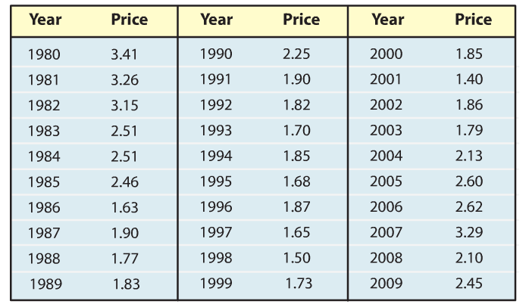
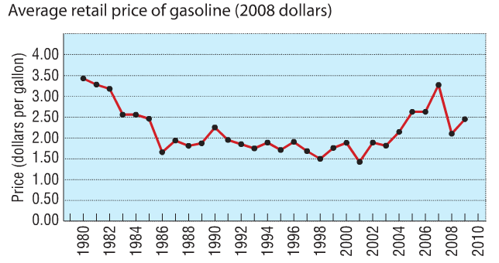
Average Price of Gasoline at a particular station in Texas
Copyright © 2012 Pearson Education, Inc. Publishing as Prentice Hall.

Slide 3

Copyright © 2012 Pearson Education, Inc. Publishing as Prentice Hall.

Slide 4

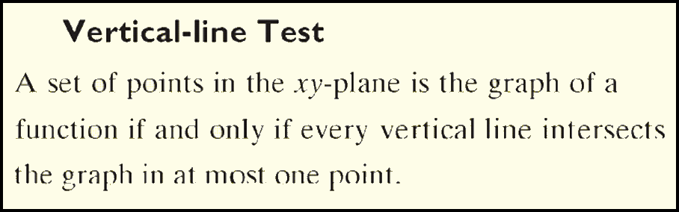
Copyright © 2012 Pearson Education, Inc. Publishing as Prentice Hall.

Slide 5

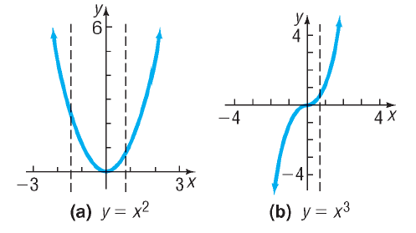
Which of the following are graphs of functions?
A Function
A Function
Copyright © 2012 Pearson Education, Inc. Publishing as Prentice Hall.

Slide 6
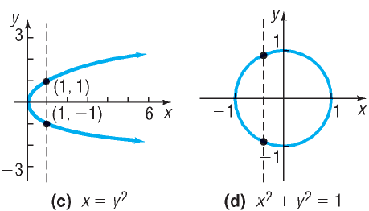
Which of the following are graphs of functions?
Not A Function
Not A Function
Copyright © 2012 Pearson Education, Inc. Publishing as Prentice Hall.

Slide 7
Copyright © 2012 Pearson Education, Inc. Publishing as Prentice Hall.

Slide 8

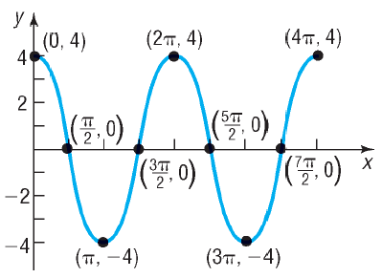
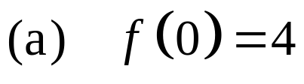

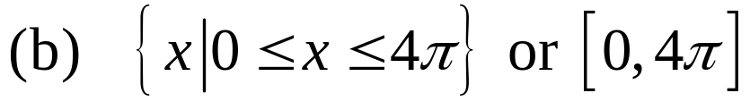

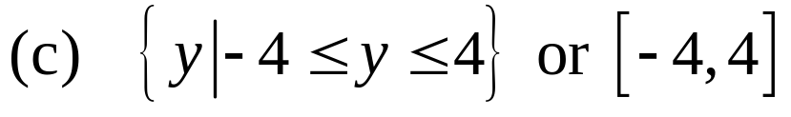








Four times.
Copyright © 2012 Pearson Education, Inc. Publishing as Prentice Hall.

Slide 9
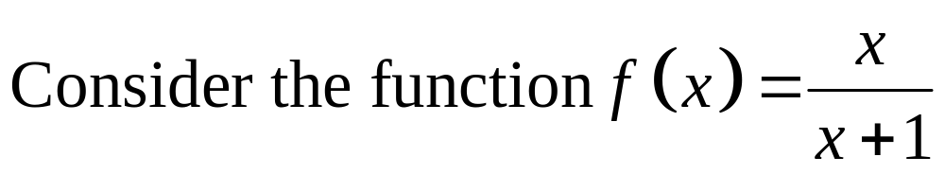

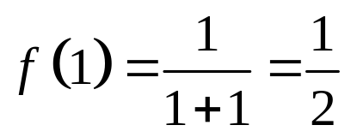
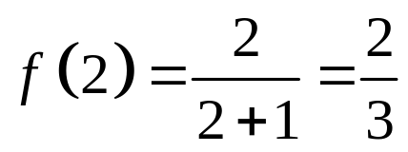
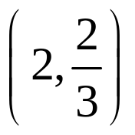
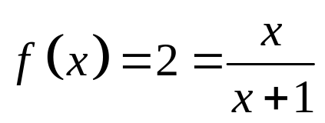
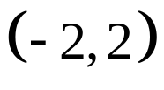
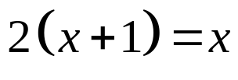


Yes
Copyright © 2012 Pearson Education, Inc. Publishing as Prentice Hall.

Slide 10

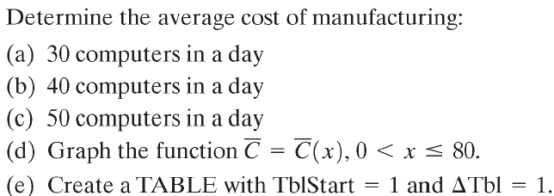


Copyright © 2012 Pearson Education, Inc. Publishing as Prentice Hall.

Slide 11






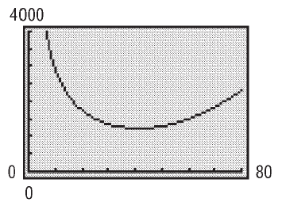
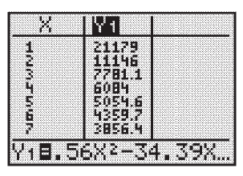
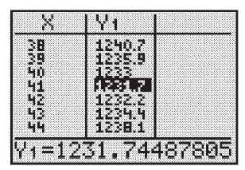
x = 41.
Copyright © 2012 Pearson Education, Inc. Publishing as Prentice Hall.

Slide 12
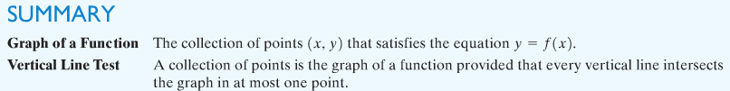
Copyright © 2012 Pearson Education, Inc. Publishing as Prentice Hall.

